Slide 1


MAXHUB universal console
Date: 2025.09
Notes:
开场（约 1 分钟）
各位同学大家好！今天非常高兴能有机会在这里与大家深入交流我们这款极具竞争力的videobar新品XBar U50，相信通过接下来的十分钟，大家会对它有全方位的了解，从而在市场推广中更有信心和底气。
2025年MAXHUB推出全新XBar系列产品，作为全新一代的MTR videobar系列产品预计在2025年IFC做全面发布，其中包括四款产品 覆盖MTR-W MTR-A两大生态系统和small、medium、large room。

Slide 2
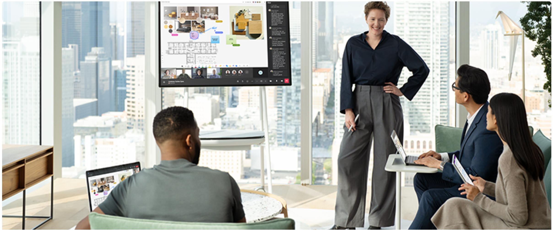
Universal Console（The first universal console for surface hub 3）
To make the in-room meeting experience for user even easier, we’re adding a universal console for control Surface Hub 3 in a Teams meeting
Notes:
核心卖点：
行业最好的光学拼接影像系统方案，超大视野125°，超大底图像传感器提供超高清晰图像
优秀的NPU算力支撑更好的音视频性能和AI功能体验
具备12个高性能麦克风阵列，搭配AI降噪算法，提供更好会议拾音能力
具备2个15瓦超大功率全频扬声器，4个低音反射板，输出更好的会议音频
快速安装设计，无需辅助安装设备
全环保包装设计，可降解材质

Slide 3

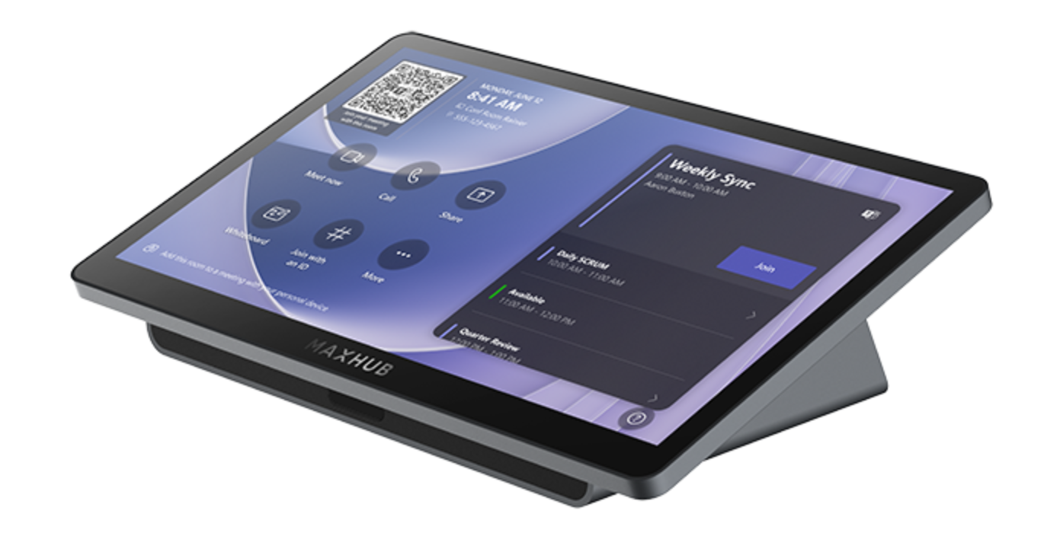
Universal Console——TCP33T for surface hub 3
`
Screen
Feature
11.6 inch large size
FHD display resolution
Mutil-touch panel
Anti-glare&Anti-finger
join meeting
camera on/mute
micphone on/mute
admit join meeting
Performance
Design
The 1st universal console for surface hub 3
1080P content sharing
USB-C plugin ingest
motion sensor
install on the desk
install on the wall
join meeting
control meeting
wire ingest
wake up
Notes:
核心卖点：
行业最好的光学拼接影像系统方案，超大视野125°，超大底图像传感器提供超高清晰图像
优秀的NPU算力支撑更好的音视频性能和AI功能体验
具备12个高性能麦克风阵列，搭配AI降噪算法，提供更好会议拾音能力
具备2个15瓦超大功率全频扬声器，4个低音反射板，输出更好的会议音频
快速安装设计，无需辅助安装设备
全环保包装设计，可降解材质

Slide 4
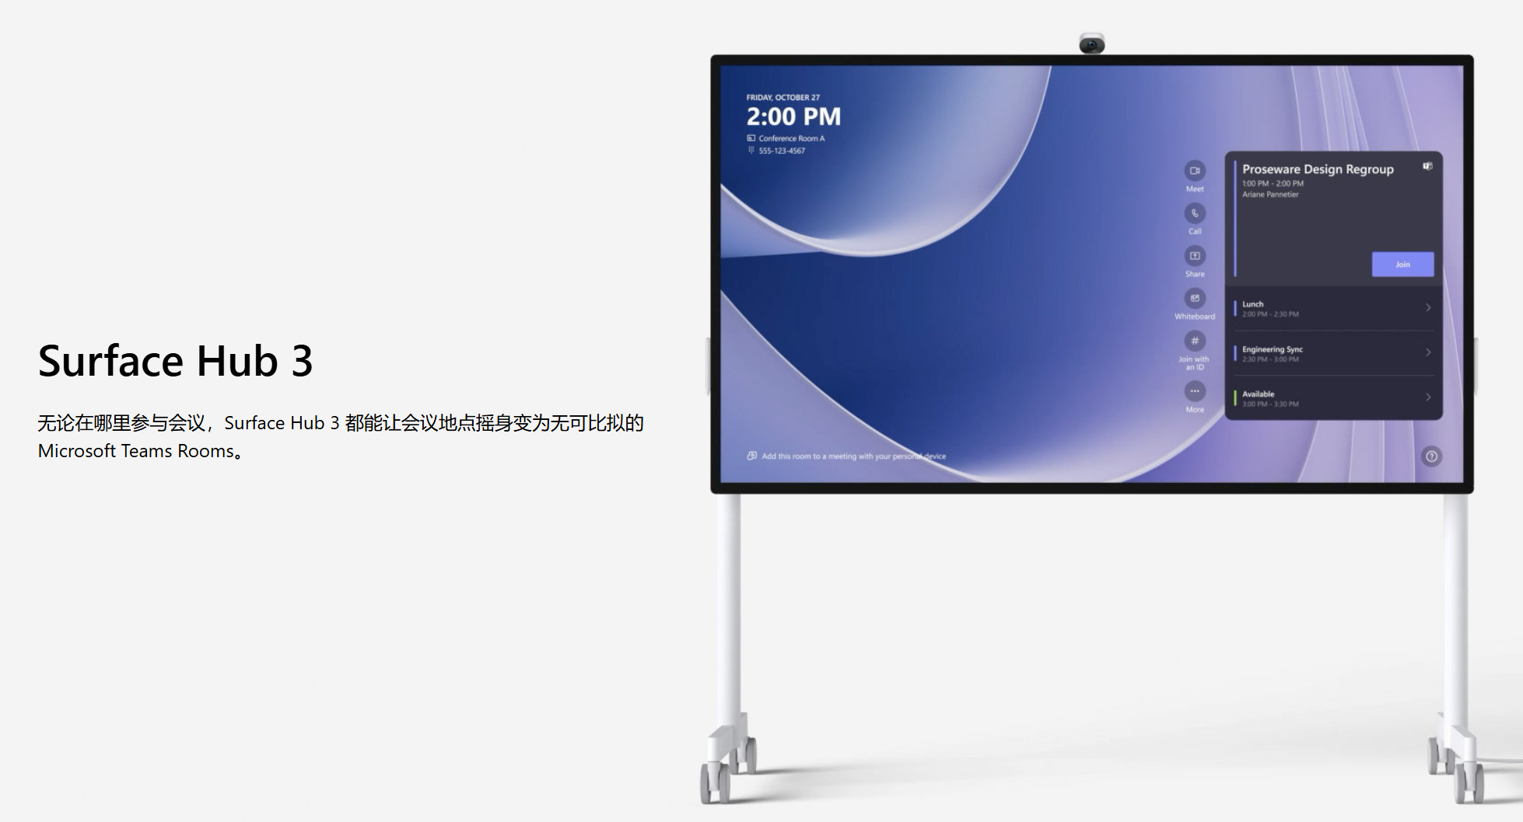
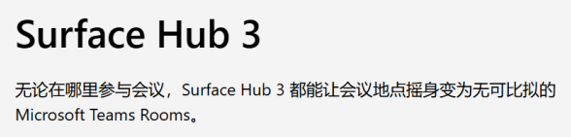


Universal Console——TCP33T for surface hub 3 for user value
Raise efficiency for meeting
Join meeting from console
Admit join meeting appliy or add member
Control micphone、speaker or camera on/mute
Ingest from console USB-C cable

Slide 5
Universal Console——TCP33T for surface hub 3 for user value
Our product solution addresses what pain points
Current situation | Our product solution | User benefit & Value
Surface Hub lacks a desktop console—meeting controls require moving to the front meeting board, which is troublesome and inflexible. | We provide the first universal conosole suitable to surface hub & MAXHUB V7 meeting board. | Cut down the need to move from seat to the front board for controls, boosting meeting efficiency.
No console fits Surface Hub well. | Reduce screen reflections, keep the screen clear with no fingerprint marks, lowering the need to wipe it. | Decrease movements caused by screen reflections or cleaning; Enhance visual experience and meeting efficiency.
Surface Hub uses thick, hard-to-move HDMI cables for content sharing. | Integrate USB - C content sharing; connect the console to the meeting board via easy - to - install RJ - 45 cables. | USB - C cables make linking laptops simple and easy to use.

Slide 6
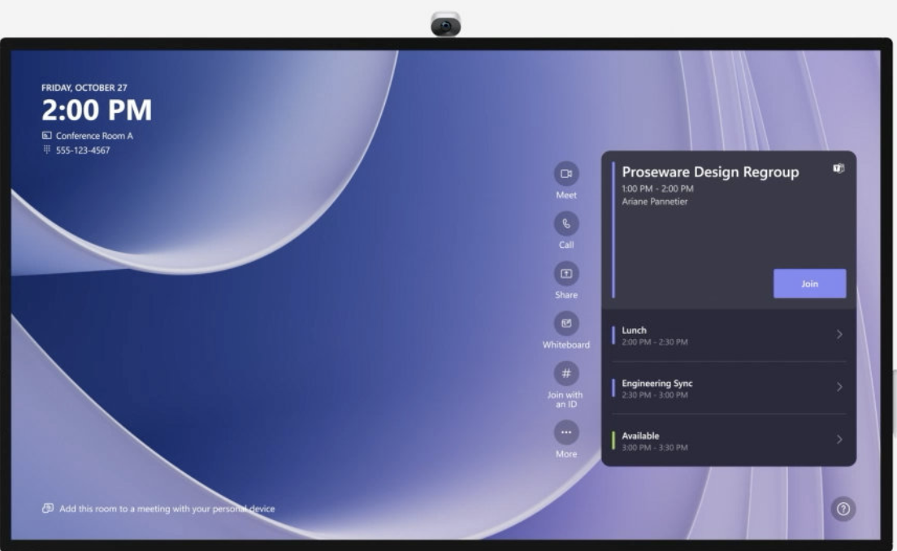
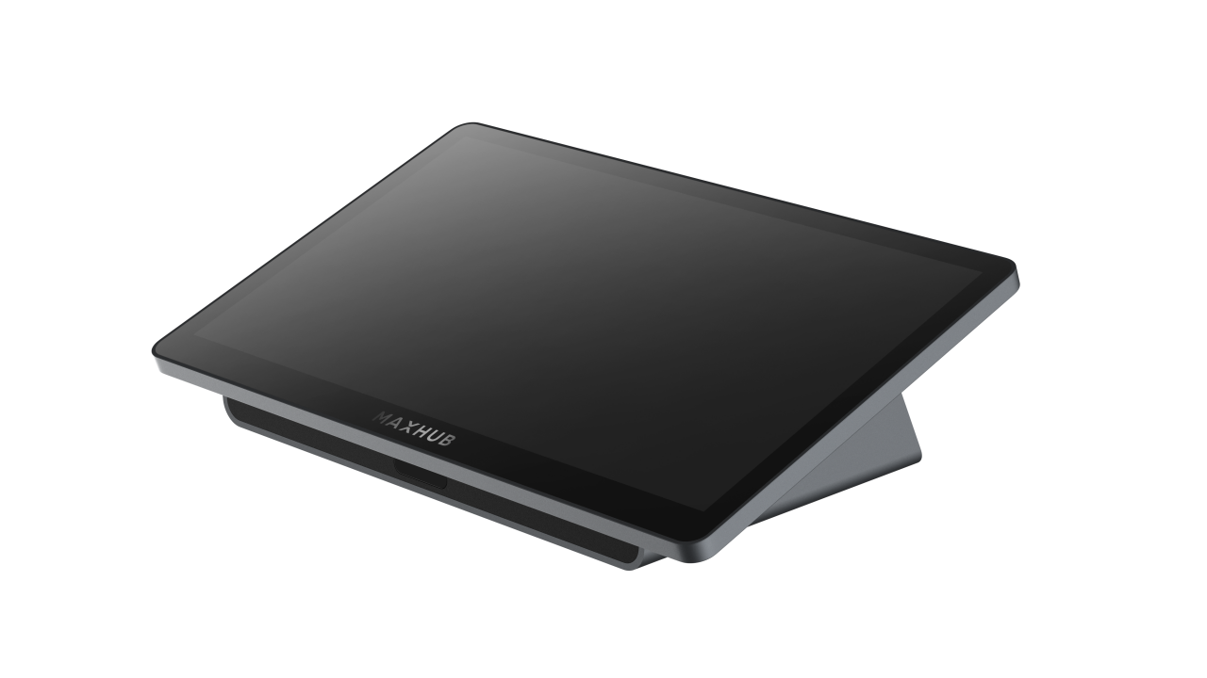
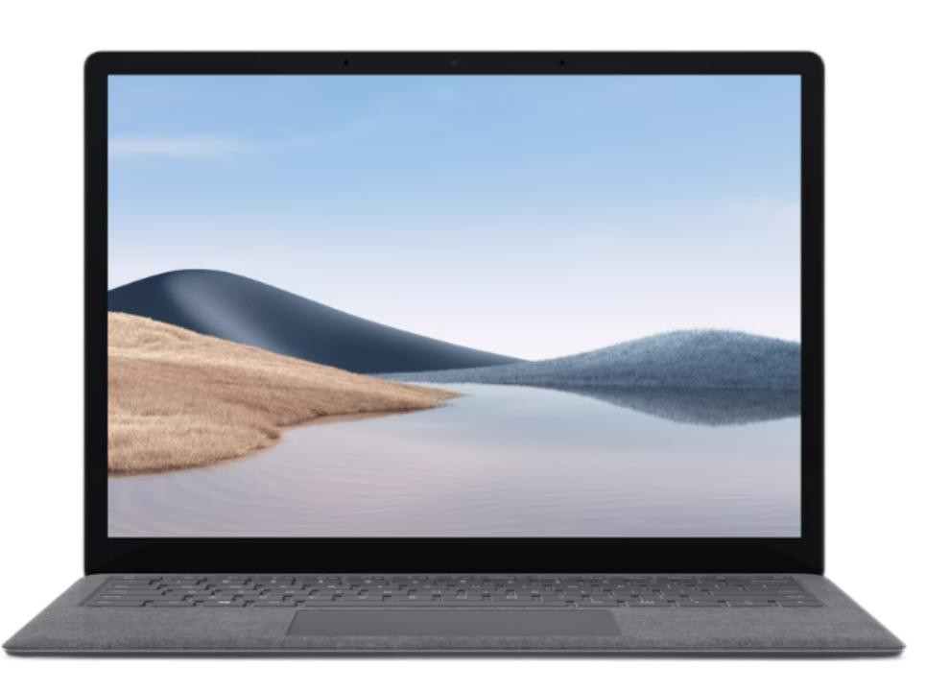
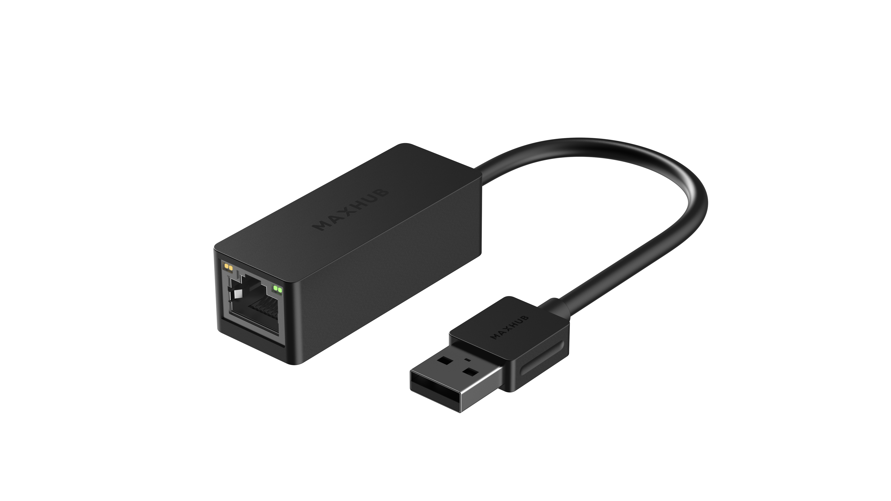
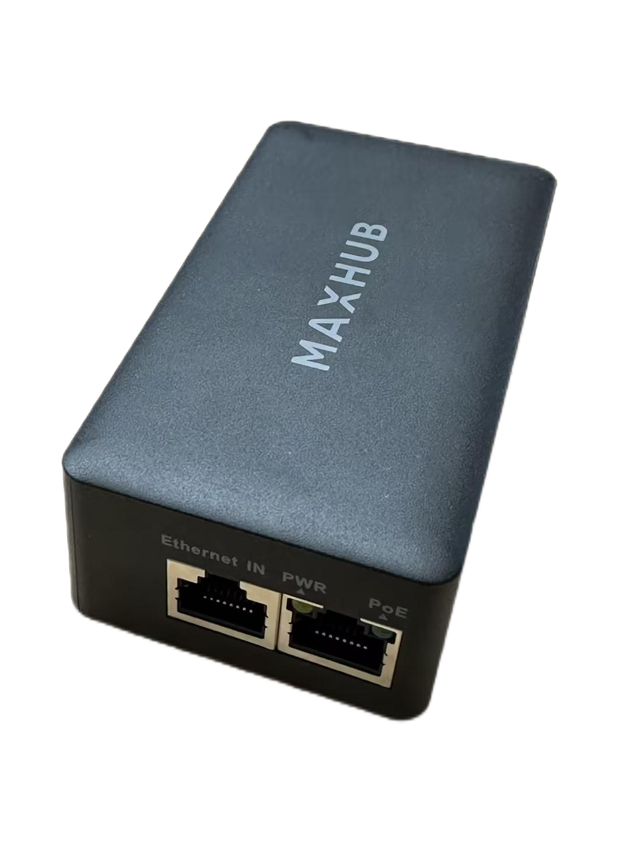
Usage Scenarios：
universal console Connection Diagrams for Surface hub
Surface hub
USB 2.0
RJ45
RJ45
console
TCP33T
Power Adapter（POE）
RJ45
USB

Slide 7
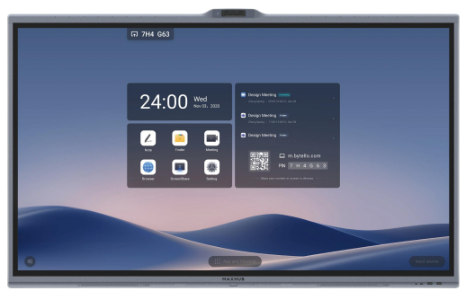
Usage Scenarios：
universal console Connection Diagrams for MAXHUB V7 MTR
MAXHUB V7 MTR
RJ45
console
TCP33T
RJ45
USB

Slide 8
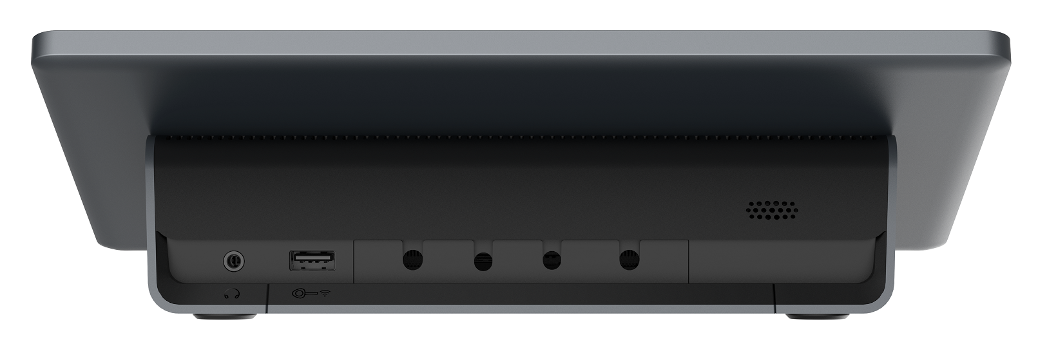
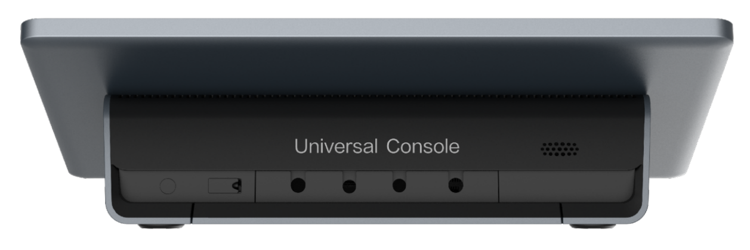
Universal Console——what’s different with TCP30T
As you can see below two picture of two type console that the TCP33T have a “universal console” type of mark in back.
And this mark is very obvious.
  TCP30T
  TCP33T
Notes:
产品采用全环保材料设计，取消EPE等非环保材料的使用。包装箱不仅环保也考虑了开箱用户体验，可单人开箱到安装好整套设备

Slide 9
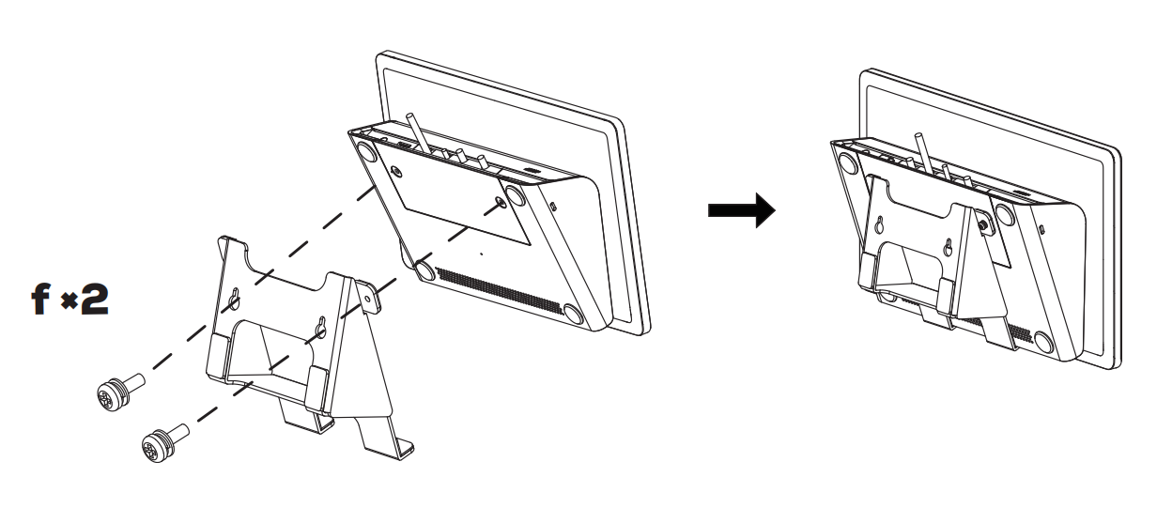
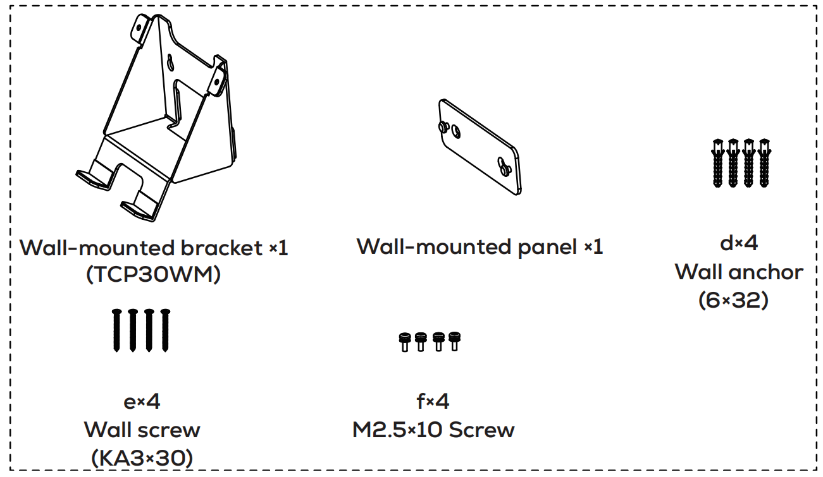
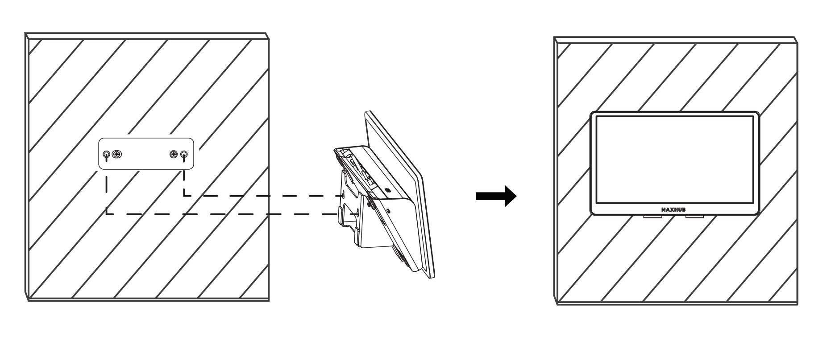
Universal Console——installation on the wall mounting
As you can see below picture about optional mounting that the TCP33T have a on the wall bracket accessories.
  wall-mounted bracket accessories
Notes:
产品采用全环保材料设计，取消EPE等非环保材料的使用。包装箱不仅环保也考虑了开箱用户体验，可单人开箱到安装好整套设备

Slide 10
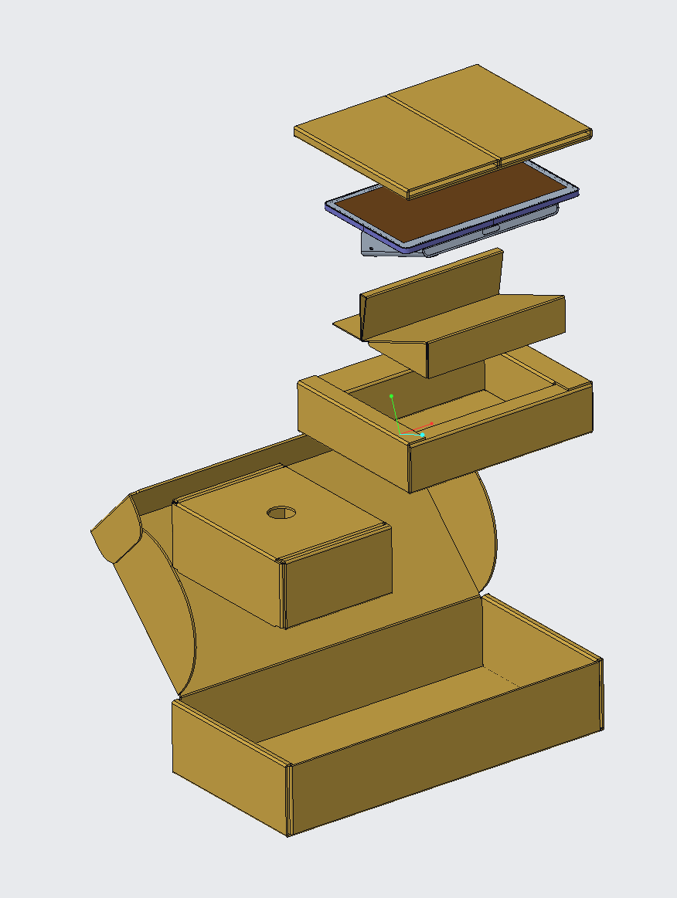
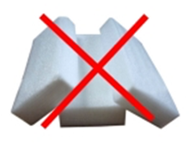
Universal Console——Package including & Material
Packaging selection of environmental degradable materials，and the box is stronger.
A thinner packaging design also helps to reduce the carbon emissions generated by product transportation.
universal console kit | Console
 | Data Adapter （USB to RJ45）
 | Power Adapter
Notes:
产品采用全环保材料设计，取消EPE等非环保材料的使用。包装箱不仅环保也考虑了开箱用户体验，可单人开箱到安装好整套设备

Slide 11





Thanks.
www.maxhub.com
MAXHUB
sales@maxhub.com

